Slide 1
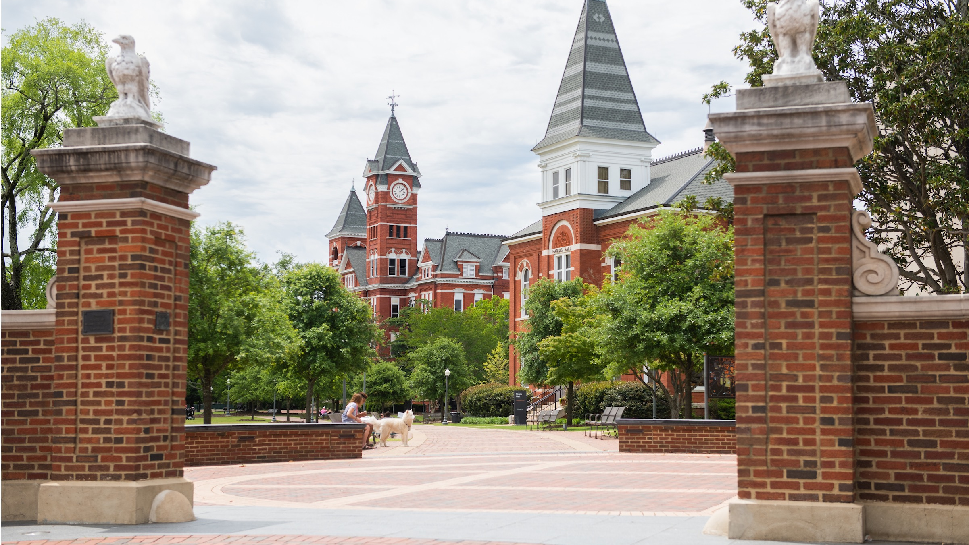

Fraud Findings
The Latest scams and schemes
Kevin Robinson
Vice President for Institutional Compliance & Security
Auburn University

Slide 2

Fraud Findings – What’s Ahead
Some Basic Reminders
ACFE’s Report to the Nations
Case in Point
FBI Recent Bulletin
3 Recent Cases at AU

Slide 3
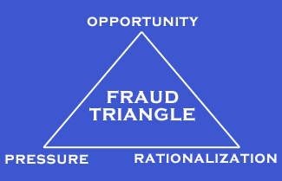
The Fraud Triangle

Slide 4
Fraud Quick Facts – Implication of Each
Most fraud is found by employees simply paying attention.
Perception of detection is the best deterrent to fraud.
Poor internal controls are the root of most every fraud.

Slide 5

Theorem - An idea that has been demonstrated as true or is assumed to be so demonstrable.
Robinsons Theorem of Fraud Opportunity
a person with complete control of a process, that fully understands the system for which they have complete control, is extremely dangerous to the organization…
this risk is exponentially raised when you have complete trust in them.

Slide 6


Slide 7
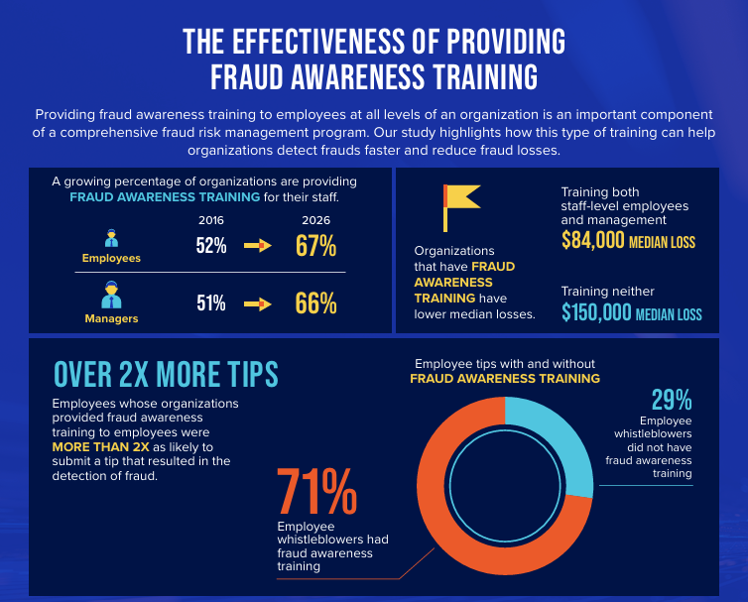

Slide 8
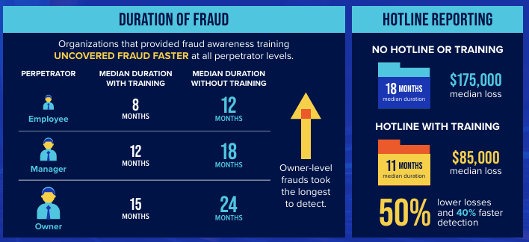

Slide 9
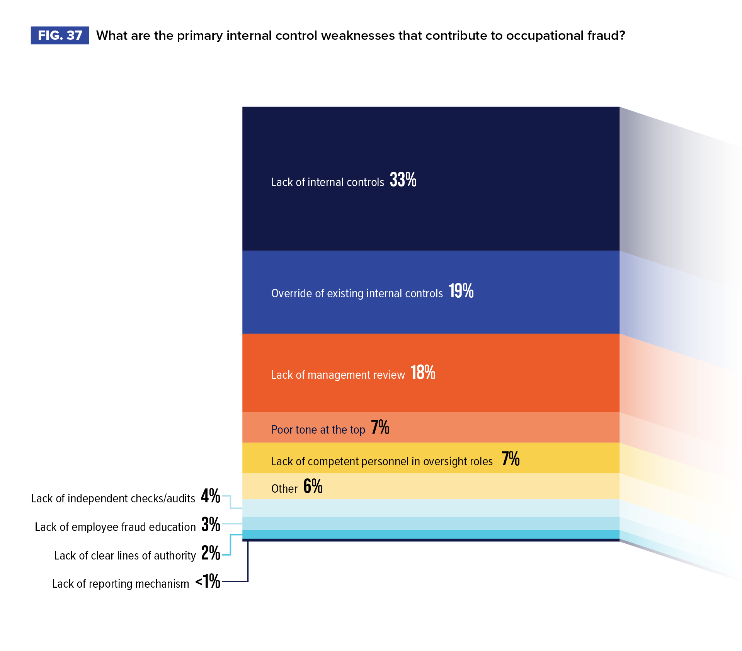

Slide 10

ACFE Report:
Top Occupational Fraud Schemes in Education
1. Corruption
2 . Billing
3. Expense Reimbursement
4. Payroll
5. Cash & Non Cash

Slide 11

Median Loss
Based on Education
High School - $55,000
Some College - $100,000
College Degree - $145,000
Postgraduate Degree - $234,000
Encouraging stats - this shows the importance of education!

Slide 12
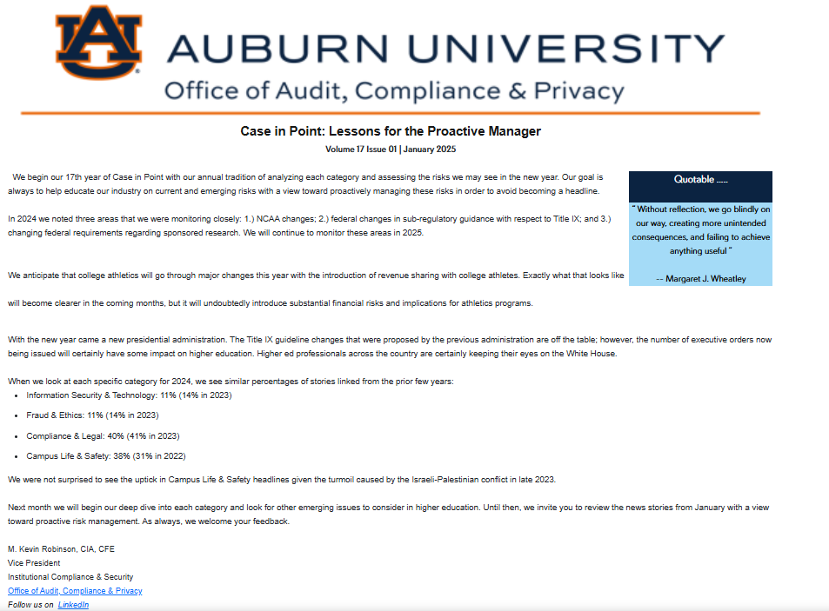

Slide 13
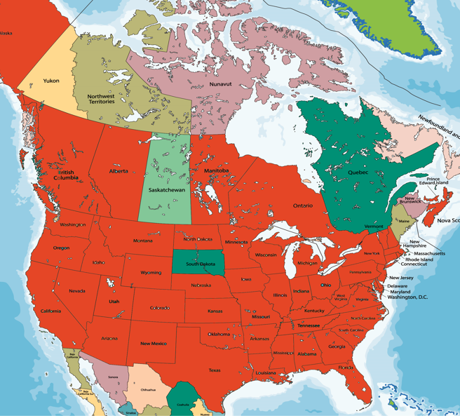
Case in Point: Now in our 18th Year
Monitoring Risk in Higher Education
Internationally
  Australia
  Hong Kong
  Lebanon
  Morocco
  Nambia
  Argentina

Slide 14
Case in Point 2025 Most Common Fraud & Ethics Stories
Financial Aid Fraud
Occupational Fraud
Academic Fraud (particularly AI related)
Financial Mismanagement
Foreign Funds

Slide 15
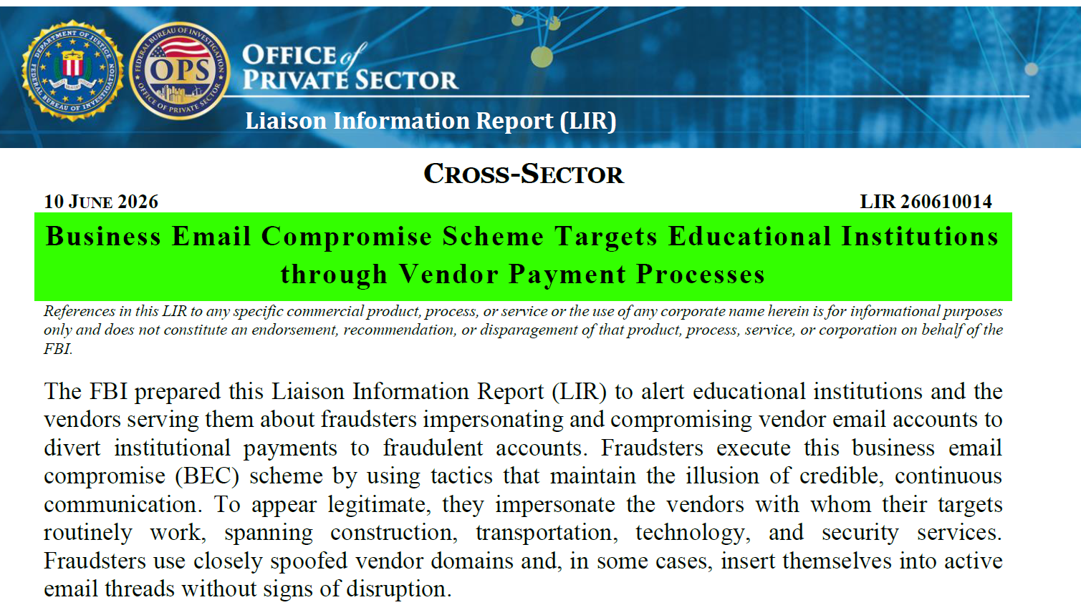
FBI

Slide 16
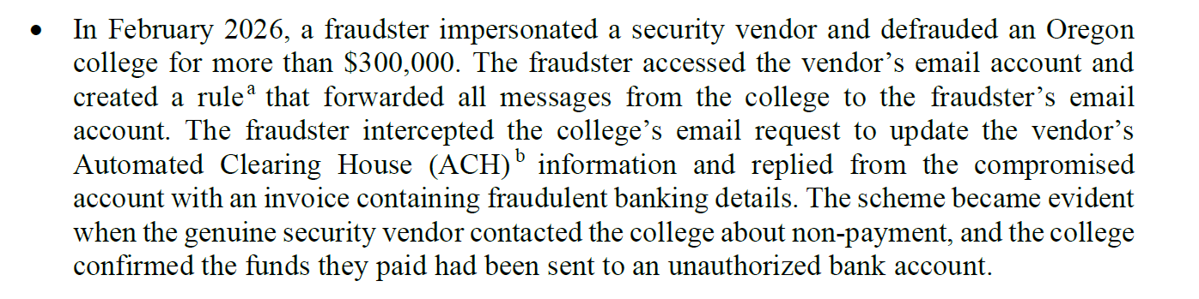

Slide 17
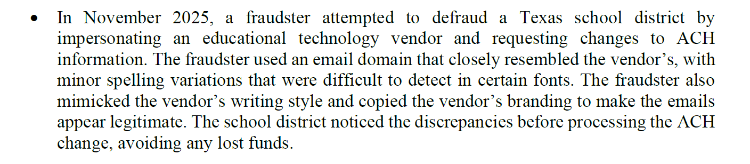

Slide 18
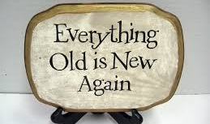
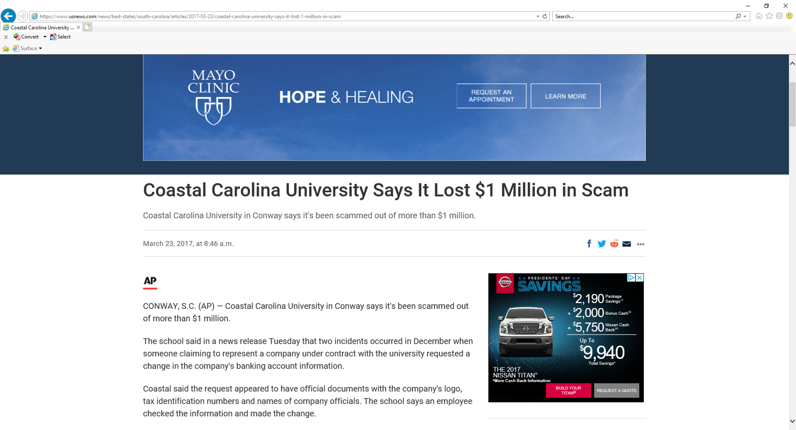
In 2017 the same scam hit higher education

Slide 19
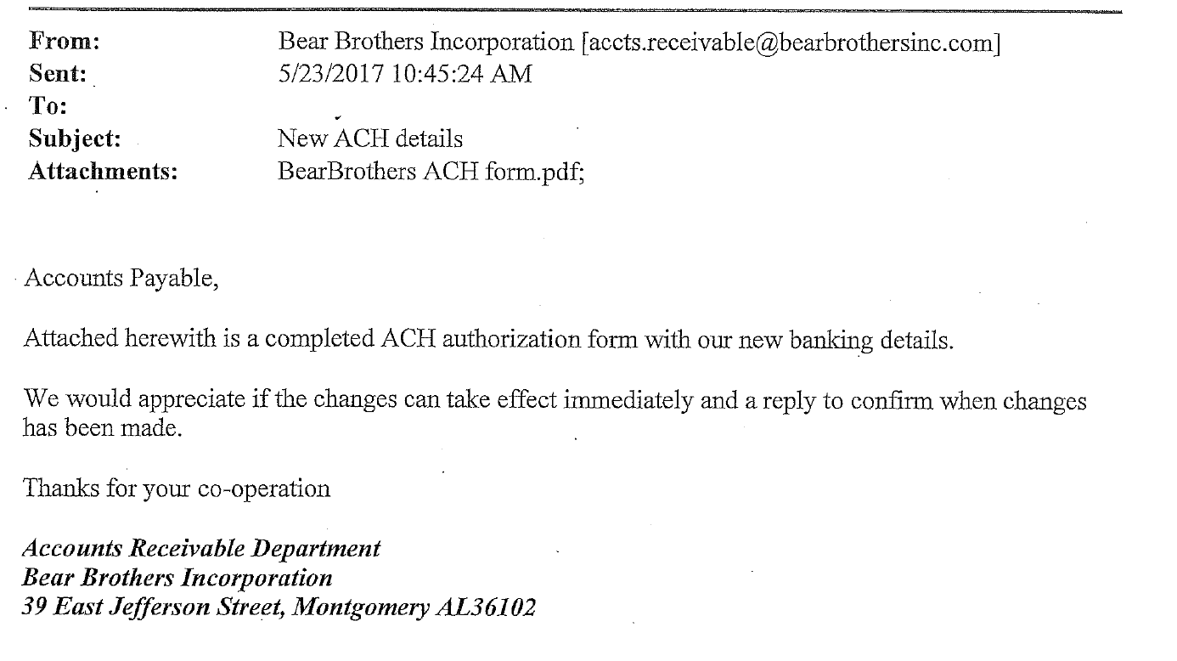

Slide 20
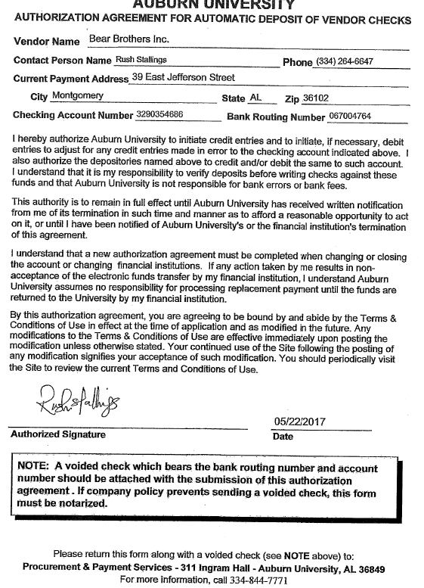

Slide 21
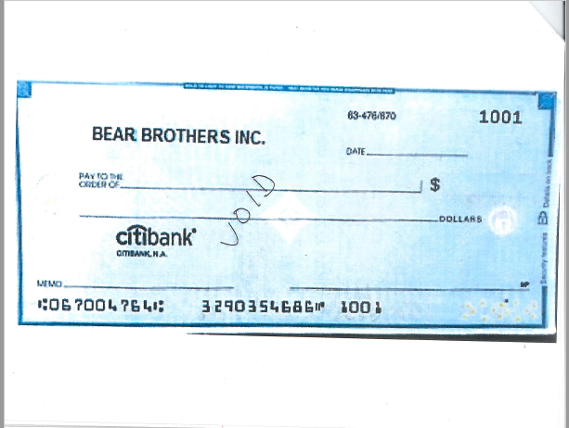

Slide 22
Lessons
Importance of Communication
Importance of Monitoring
Importance of Controls

Slide 23

AU Recent Case: Flexible Spending Isn’t That Flexible

Slide 24
AU Recent Case: Flexible Spending Isn’t That Flexible
Major professor approaches their grad student with a proposal.
Funds left in FSA
How about creating receipts for childcare and we split funds?
Grad Student uncomfortable with proposal, declines offer.
Major professor continues pressure, not knowing student began recording conversations and documenting situation.
Report filed on EthicsLine
“Silver Platter”
Termination procedures underway against tenured faculty member

Slide 25

AU Recent Case: Bugged by the Spending of the Entomology Professor
Case began when PBS questioned travel that looked like a vacation.
  Wellness retreat including sex therapy
  Multiple wellness trips discovered

Slide 26
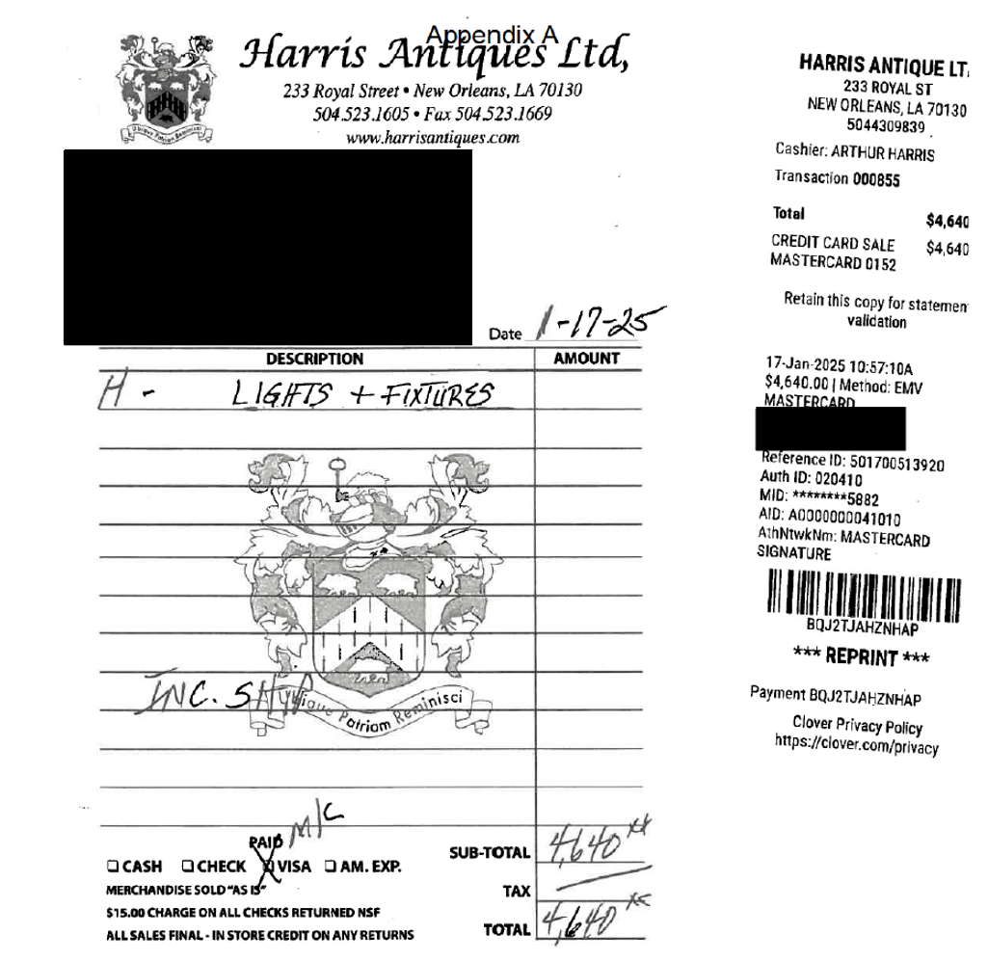
Bug Lady gets more suspicious

Slide 27
Wait I can explain Takes 1-3
I was at a conference in New Orleans and “was inspired” and any light can be turned into a bug catcher.
I was simply testing PBS processes as an opportunity help teach them and learn…I’m a teacher
My office was just really dreary and needed brightening up.
Note – professor indicated that our audit had traumatized her; however, dismissal procedures are continuing.

Slide 28
Supply Chain Professor Supplies a Fake Letter
Professor was unhappy with life and wanted more discretionary funds for travel etc.
Professor interviews with another institution and doesn’t get an offer but gets the idea to create a fake offer on letterhead he created that included the signature of the department head at the other institution.
Dean considers adding funds to keep professor, but it turns out people talk in higher education and it is learned that no offer was ever extended.
Professor resigns to avoid the termination proceedings.

Slide 29
My Advice to You
Make sure you communicate the vendor imposter fraud trend to your procurement folks.
Train your employees on fraud prevention, internal controls, ethics, and the like.
Read Case in Point monthly to see what’s happening in higher education.

Slide 30

Questions or Comments
Contact Information
Kevin Robinson
Vice President for Institutional Compliance & Security
Phone (Office) 334-844-4389
Phone (Cell) 334-744-1250
Email: robinmk@auburn.edu

