Slide 1
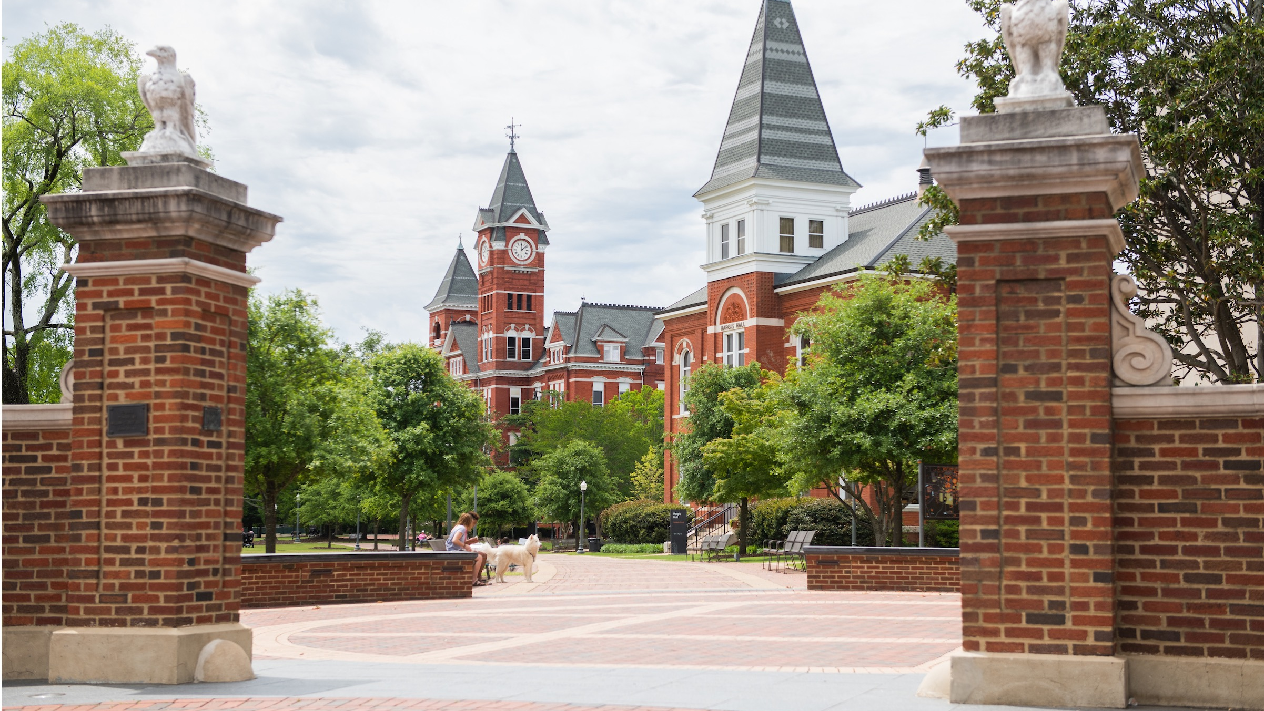

The long view
Leadership (and Life) lessons from the inside up
Kevin Robinson
Vice President for Institutional Compliance & Security
Auburn University
Notes:
Chat GPT title – new material – feedback desired

Slide 2


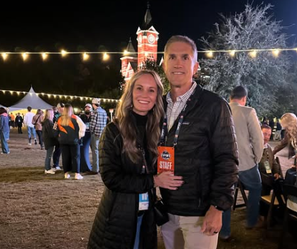
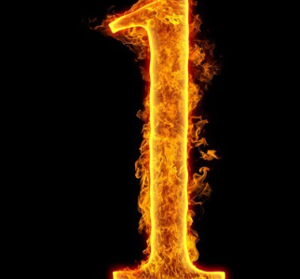
By the Numbers
Notes:
Years at auburn, years reporting to board and president, why not retire? 1 reason

Slide 3
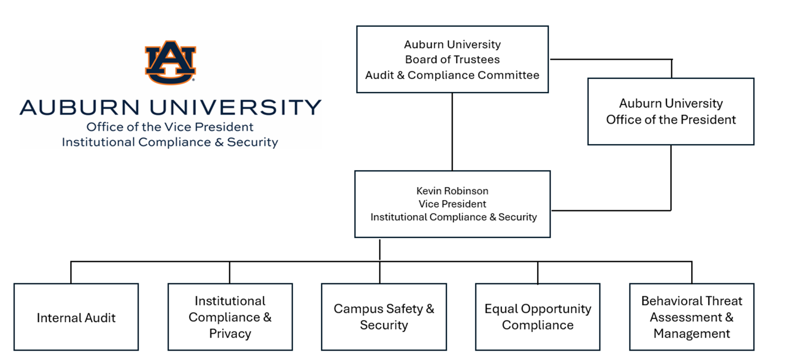
Notes:
Tell my story – IA to 10 years ago building ICP, to 3 plus ago fixing CSS and EOC . Over the years I’ve lead a lot of different organizations: acua, been part of a financial institutions board, a tennis association, a ministry but last 3 years have taught me more on leadership than just about any

Slide 4
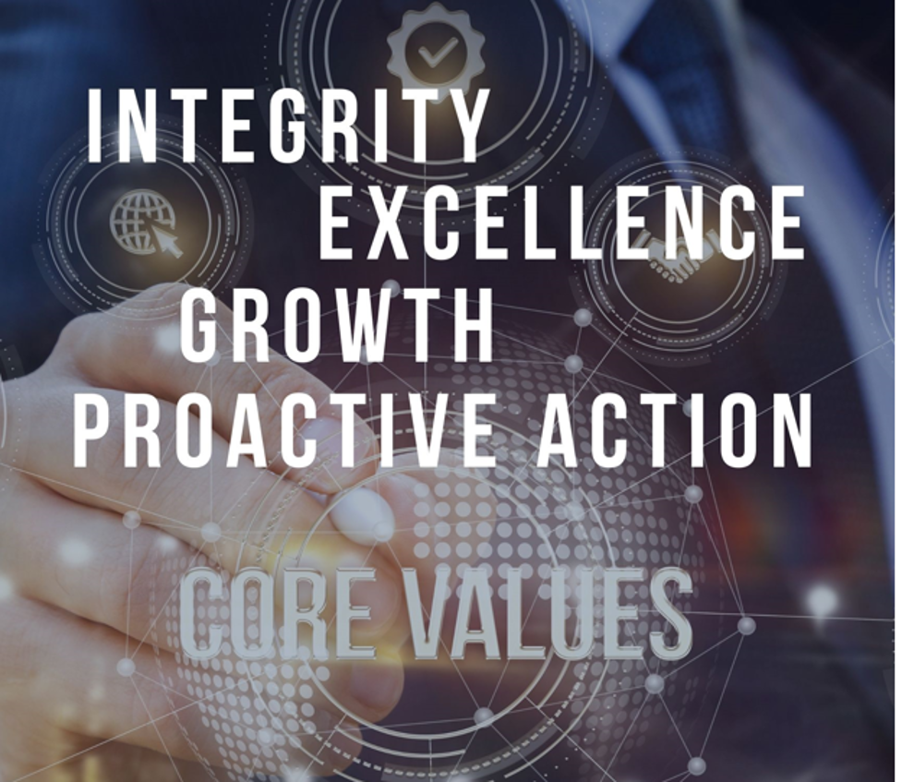
Notes:
If you haven’t identified your areas values I’d encourage you to; my group hears me discuss our values and that this is the lens I want them to approach work through

Slide 5
Today’s Goal
Share Some Stories
Impart Lessons
Laugh & Have Some Fun

Slide 6

Most Common Thing Remembered From the Average Conference Talk

Slide 7

A favor I have to ask…
Find one thing in this talk and apply it in some way to be a little better at life.

Slide 8
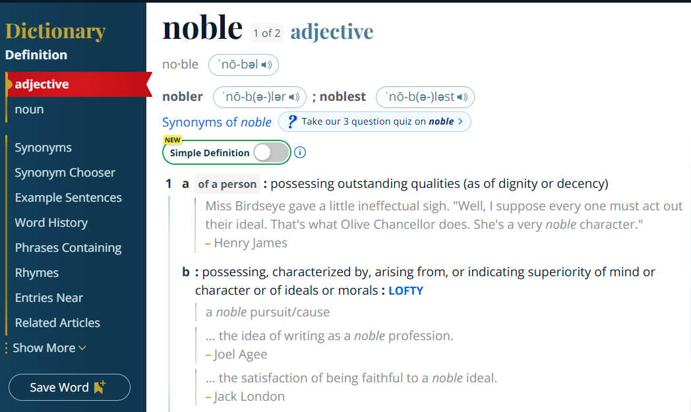
Reminder on Higher Education
Changing lives through education
Transforming society through research
Reaching out to those who need help
Notes:
First Gen college kid; roommate story

Slide 9
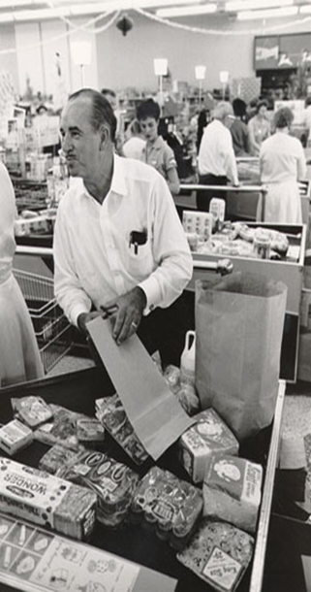
Is your organization better because of you?
“Publix will be a little better place, or not quite as good because of you.”
George Jenkins, Founder Publix Grocery

Slide 10
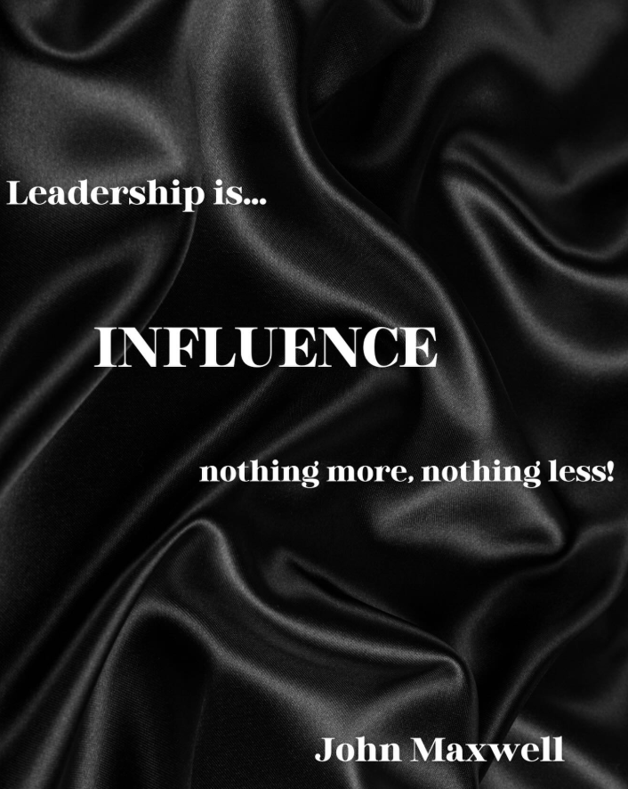
Leadership

Slide 11

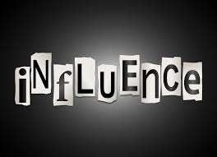
Weapons of Influence
Reciprocity
Commitment & Consistency
Social Proof
Liking
Authority
Scarcity
          Source Dr. Robert B. Cialdini
Notes:
people are not formulas – not all will be impacted by every one the same way; but its important we know how to influence others from a fraud prevention standpoint IC are important and you all are the experts in this

Slide 12
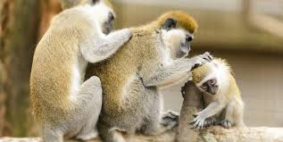
Influence Principle: Reciprocity
People have an innate desire to repay what another person has done for them.
Notes:
Address labels from some organization raising money 18-40 % response; Xmas card research

Slide 13
Reciprocity Points
Sociologist have found this rule in all societies, and it doesn’t matter if initial favor is unwanted.
You can increase the effectiveness of this principle returning to you with this phrase, “I know you’d do the same for me.”
You can effectively squelch this principle by responding with, “Oh it was nothing.”

Slide 14
Commitment & Consistency
Once we have made a choice or taken a stand, we encounter personal pressure to behave consistently with that commitment/decision.
Notes:
Beach Theft Research 20% to 98% ; so anytime you can get someone to commit to something you set the stage for future compliance.
You can use this principle on yourself to some degree write down goals and even better tell someone about it

Slide 15
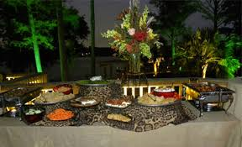
Social Proof
We look to the actions of others to determine what is the correct or acceptable behavior.
Notes:
President’s house, walk in food out; bar tip jars seeding; bystanders not getting involved in say a medical emergency

Slide 16
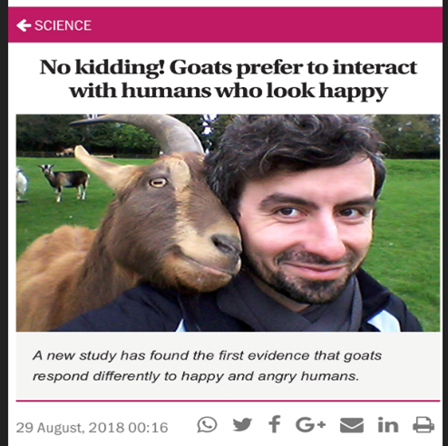
Influence Principle:
Liking
We are more influenced by people we like.
Notes:
People we like we are more apt to respond to their requests

Slide 17
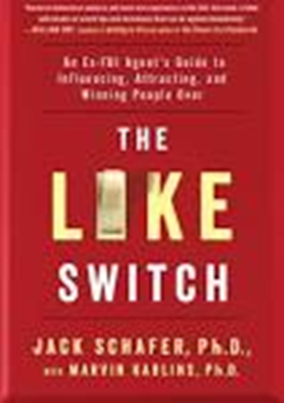
The Like Switch
Body Language
Friend Signals vs Foe Signals
  Eyebrow raise, head tilt, smile
Notes:
Hugo story from Arkansas trip

Slide 18
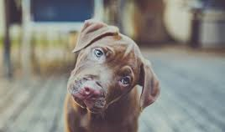
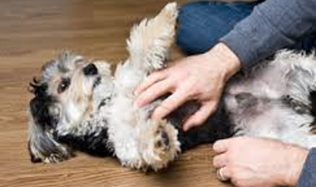
Friend Signals as seen in the animal kingdom

Slide 19
Listening
We speak between 125-175 words per minute.
We can listen at 400 words per minute.
This gap brings danger to communication.

Slide 20
Great Listening
Clear the internal clutter
  Mindfulness
  Breathing
  Hydration
Remove distractions
Focus on what is said and what is not said.
Eye contact, avoid interrupting, realize silence is okay.

Slide 21
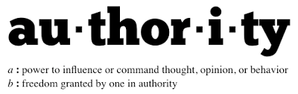
Influence Principle: Authority
People are more influenced by those that are viewed as authorities.

Slide 22
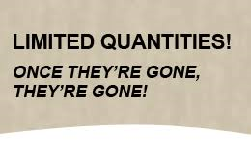

Scarcity
People tend to want things that are in limited supply.

Slide 23
Weapons of Influence
Reciprocity
Commitment & Consistency
Social Proof
Liking
Authority
Scarcity
          Source Dr. Robert B. Cialdini
Notes:
people are not formulas – not all will be impacted by every one the same way; but its important we know how to influence others from a fraud prevention standpoint IC are important and you all are the experts in this

Slide 24
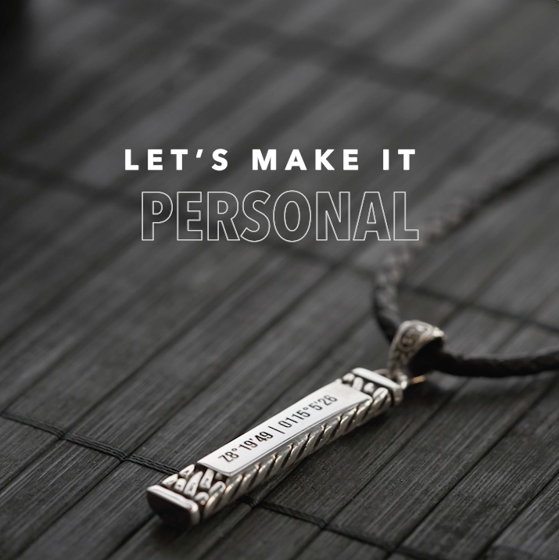
Influence is a worthy topic but…

Slide 25
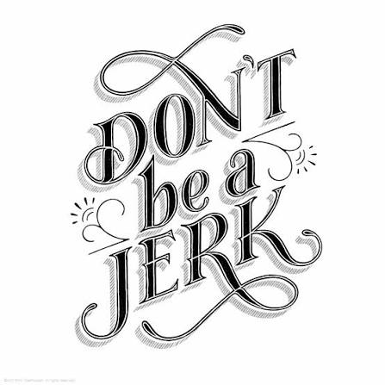
Lessons from Sue
Even when you think you have the right to be.
Your words impact people more than you realize.

Slide 26
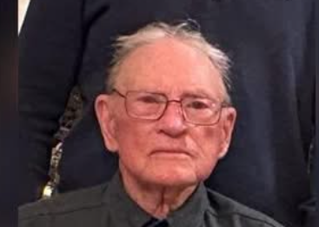
Thoughts on Work Ethic From Kenneth A. Robinson
“Son if you hire yourself out for a job and don’t work hard, you are stealing.”
Working with Don.
“It’s not my job" shouldn’t be in your vocabulary.

Slide 27

It will ultimately determine your life experience
Choose your frame carefully.

Slide 28
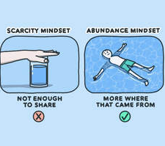
Related to your frame…Mindset Choice
Abundance vs Scarcity
Notes:
1 in 400 trillion chance you are even born.

Slide 29
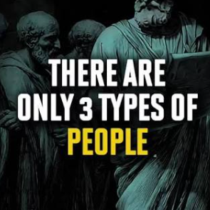
Buffalo Bill & His Advice to a College Intern: 3 Kinds of People in the World
People that know.
People that don’t know.
People that don’t know they don’t know.

Slide 30

People
Fire them
Notes:
I’m being a little dramatic here, certainly work with people to turn them around. Have difficult conversations but at the end of the day, my experience with toxic people is few will change.

Slide 31
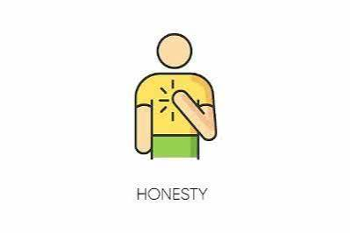

Communication
Do what you say even in small things.

Slide 32

Communication
Your body says more than you realize learn to send friend signals.
60-80 percent of communication is nonverbal

Slide 33
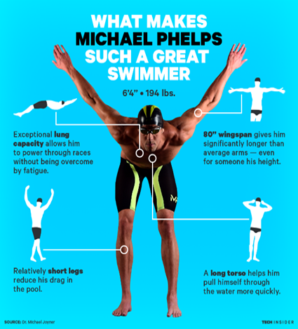
The Differentiator
He is the most successful and most decorated Olympian of all time with a total of 28 medals. Phelps also holds the all-time records for Olympic gold medals.
“There were a lot of days I didn’t want to get out of bed. If you look at the greats in any walk of life, the greats do things when they don’t always want to, and that’s the separation.” Michael Phelps

Slide 34
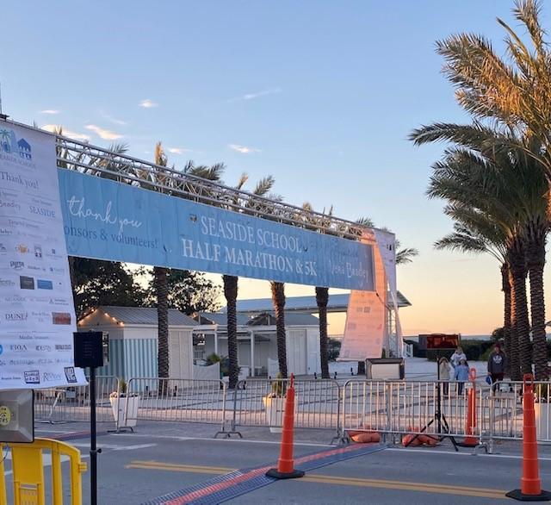
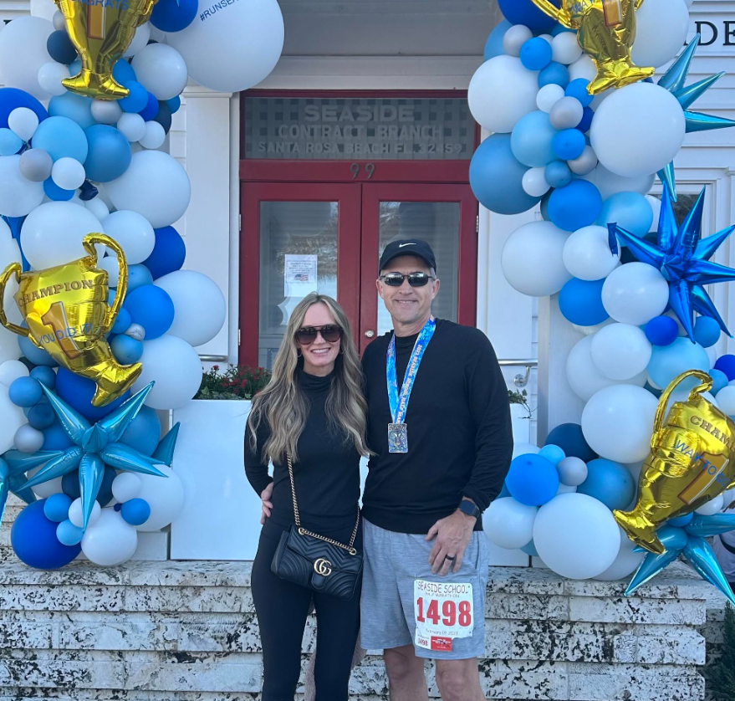
Take the Long View
Where do you want to be 10-20-30 years from now?
Make decisions starting today to get to that destination.
Daily decisions over the long term make the difference.

Slide 35
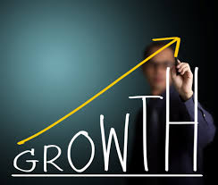
The Commitment – Continual Growth

Slide 36
Practical Suggestions
Focus on your health now.
  Movement
  Food
  Functional Health
Rituals (find what works for you for me it’s the morning).

Slide 37

“A little better or not quite as good.”
Go be Gage

Slide 38

Questions or Comments
Contact Information
Kevin Robinson
Vice President for Institutional Compliance & Security
Phone (Office) 334-844-4389
Phone (Cell) 334-744-1250
Email: robinmk@auburn.edu

