Slide 1
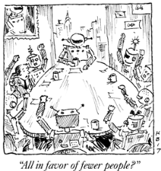

Buckle Up & Beyond
11 June 2026
Cartoon by Hank Blaustein

Slide 2
Buckle Up
Overview
Checklist
Inflation
Labor
Rates
Stocks
Beyond
Paths
DEEP
Demographics
Education
Engineering
Policy
Summary
Agenda

Slide 3
Buckle Up

Slide 4
GDP Swings - Abnormal
Abnormal
Normal
Normal
Paranormal
Data Source: FRED
*Data as of December 31st, 2025
Notes:
Any engineers in the room
Disturb a system should swing positive and negative
Should be a recession by 2022
Did not happen thanks to $6T of Deficit spending
What did happen? All that money did help M&A in 21 and 22
Hangover 23 Rebound in 24 25 NOT

Slide 5
Recession Checklist
Our recession checklist consistently has 2 to 3 items “On” No Recession next six months
Green = Good Yellow = warning Red = Bad
Indicator | Period | Warning | Active? | Status
Initial Jobless Claims | Weekly | Rising 4-week average, Uptrend | NO | Continue to drift lower
Corporate BBB 10 Year Spread | Weekly | Increasing | NO | BBB spreads near all-time tights Brief jump in March but trending lower
Treasury Yield Curve 2s - 10s | Weekly | Below 0 or Very Steep | NO | Signals competition from global rising rates
Single Family Housing Permits | Monthly | Declining | YES | Declining since December
Nondefense Capital Goods New Orders ex Aircraft | Monthly | Declining | NO | Rising & tech cap ex adding @ least ½% to GDP growth
US Consumer Expectations (Univ Michigan) | Monthly | 10 Point Decline | YES | 2nd lowest in 40 years Skewed by political affiliation
ISM Manufacturing New Orders | Monthly | Below 50 | NO | Increasing last 3 months after 11 months of contraction
Chicago Fed National Financial Conditions | Monthly | Tightening | NO | Loosening: credit readily available
Data Source: Texas Capital Private Bank, Bloomberg, Don Rissmiller, Strategas, BofA ICE C9A4 BBB Index As of March 20, 2026
Notes:
Umich switched entirely to online surveys in July 2024
Home building hurt by number of forces Regulatory Dodd Frank, Land use rules,

Slide 6
Outlook for 2026 Real GDP Growth
OK
Blah
Good
+2%
+1%
2025
-1%
+3%
Crummy
Great
2026 Forecast
2024
+5%
-3%
Data Source: Texas Capital Private Bank Economics
*Data as of December 31st, 2025
Notes:
Pre Iran We were ahead of the WS pack at 3% to 3.25% We will stay there if the Soh opens soon
Labor Day? Probably too long for the rest of the world esp Asia
For us would be a mid cycle slowdown
Think 2nd gear down to 1st

Slide 7
Economy Summary
Growth recovered from shutdowns
  Permanent changes – global trade cycle over
  Build in America
  Momentum building before February 28th
Retail Sales Holding up: +4% annual rate
Government spending going down: +1.5%
Manufacturing improving: +2%
  OBBB full expensing
  Opportunity Zones coming
Capital Expenditures rising
  Full year 2025: ~$340B 2026: ~$700B
Think 3% for rest of the year
Source: Texas Capital Private Bank Economics
Notes:
Expansions don’t die of old age; they are murdered by high rates or credit crunch

Slide 8
Inflation
Notes:
What comes along with too much money after shutdowns? Higher prices!
Inflation cycles have a trigger 1970s were oil embargos Now we have an oil shock but before the Iran producer prices were already inching higher

Slide 9
Inflation Echo Peaks
Median time to Echo – 33.5mo
Data Source: FRED
*Data as of May 2026

Slide 10
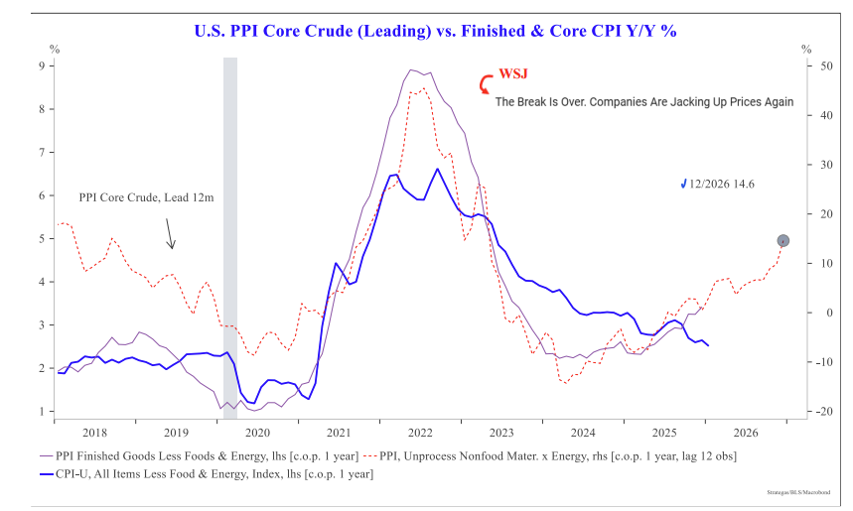
Inflation – Producer Price Pressures Building
Median time to Echo – 33.5m
Data Source: Strategas, Macrobond
*Data as of February 17, 2026
Notes:
Plan on inflation accelerating this summer through the fall
The noise makers on TV will tell you its fall out from Iran war.
The reality is Producer Prices were already rising They lead CPI by about a year

Slide 11
M2 YoY & CPI YoY
Data Source: FRED
*CPI Data as of May 31st, 2026
**M2 Data as of April 30th, 2026
Notes:
The biggest driver of long-term inflation is the growth of the money supply
M2 for short M2 leads CPI by 2 years
After the Congress binge and the Fed’s Transitory narrative on post virus shutdowns we were treated to the Fed cutting its balance sheet in 22 and 23 inflation slowed and so did GDP and the stock market.

Slide 12
Inflation Summary
3% is the floor - headed towards 4% next year
Too much money in circulation – echo peak ramping up
Fed supposed to be fighting:
  Inflation: Not so much
  Unemployment: They win!
The Fed Excuse: “Oil shocks are inflationary”
  Short-term: CPI spike
  Long-term: Works through supply chains
  Had already started before Iran war
The Fed Excuse: “Tariffs are inflationary”
  Short-term: Not this time
  Long-term: Deflationary
Source: Texas Capital Private Bank Economics
Notes:
Think 3 4

Slide 13
Labor
Notes:
3 years ago 200k / mo
Now 20k is “normal” What’s the true picture

Slide 14
Private Non-Farm Payrolls, Monthly Change
Data Source: FRED
*Data as of March 31st, 2026

Slide 15
Unemployment rises above its 36-month average…
Today
4.3%
Data Source: FRED
*Data as of May 2026

Slide 16
Rates
Notes:
Anybody care about financing costs? Borrowing rates?
High speed

Slide 17
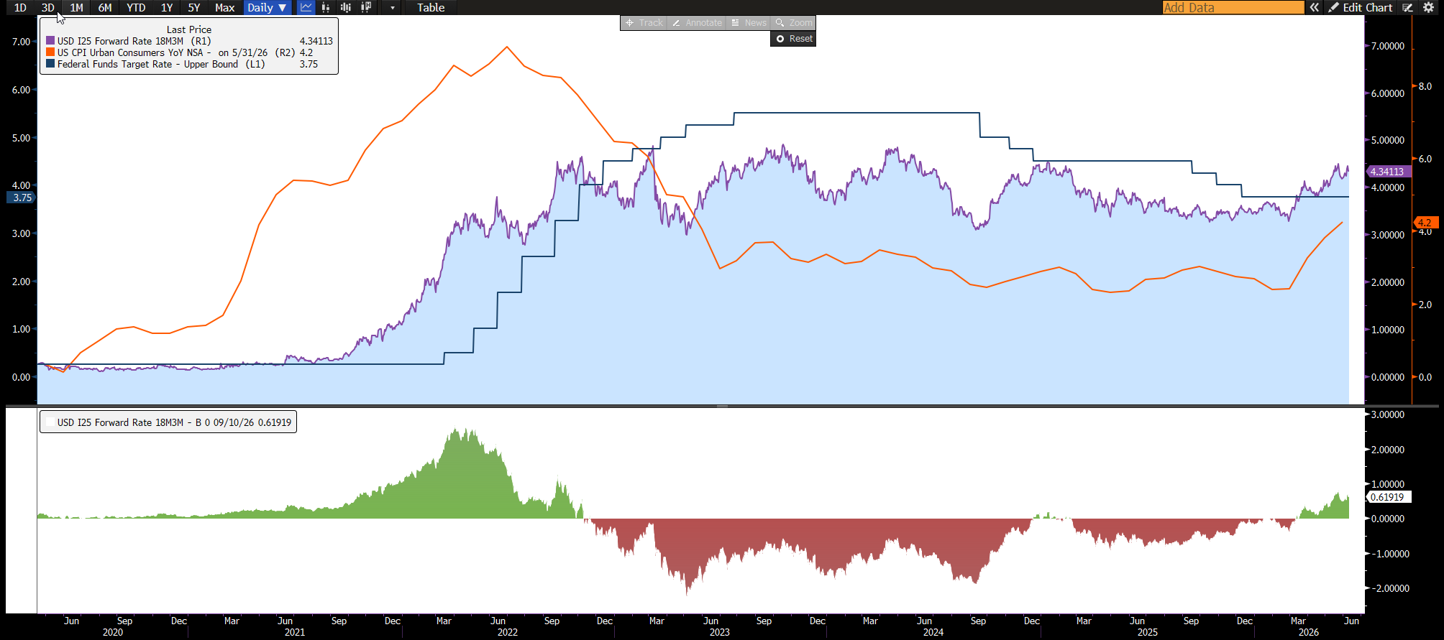
Short Term Rates – No Mas
Source: U.S. Treasury, Bloomberg
Data as of June 10, 2026
Notes:
Inflation section I could have squirrled on the Fed
Recall I barely mentioned the FOMC because they have very little actual effect on inflation.
Despite what the “experts” claim. Now I’m truly speaking as an economist so hold on to your chair
Post virus shutdown perfect example of Fed too late and killing borrowing costs.
First Inflation starts rising thanks to all that cash Congress dumped on the economy
Then the market says hey this is for real The bond market is a harsh mistress and boom Tbills and the 2 year treasury note start rising
Finally the Tooo Late Fed acts and starts raising rates. Do they raise them to the level the market wants
NO Tooo late Tooo Far Tooo Fast That’s the Fed making policy mistakes and who suffers?
Mid size borrowers who have floating rate debt Which is why our interest rate swap guys are so busy…

Slide 18
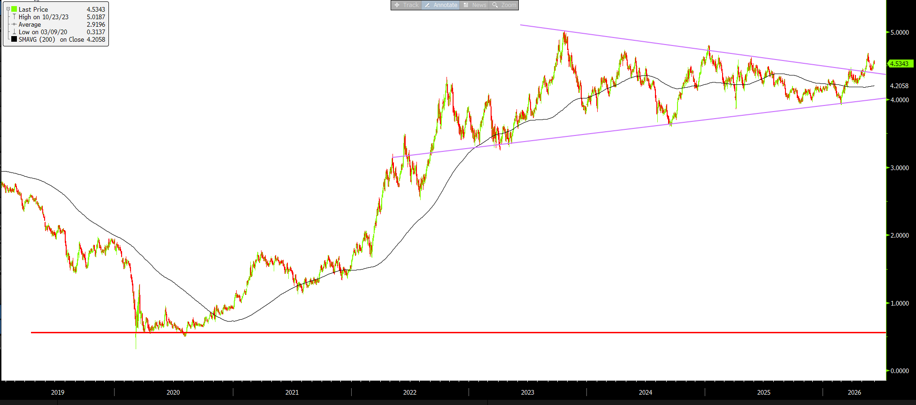
U.S. 10 Year Treasury Note
Source: U.S. Treasury Fiscal Data, Bloomberg L.P.
Data as of June 9, 2026
Notes:
Longer rates
15ish year cycle in inflation
Wall back to 1750 and you get 40 year cycles in bonds 40 up 40 down
Double bottom marked the end of the 40 yr Bull cycle
Starting the long 40 year climb again Only bubbles go straight up
Now driven by improving economy and global debt levels
Think 3 4 3

Slide 19
Stocks

Slide 20
S&P 500 Bull Markets Since 1966* (daily, percent change)
Data Source: Bloomberg
*Data as of April 16th, 2026
Notes:
Updated

Slide 21
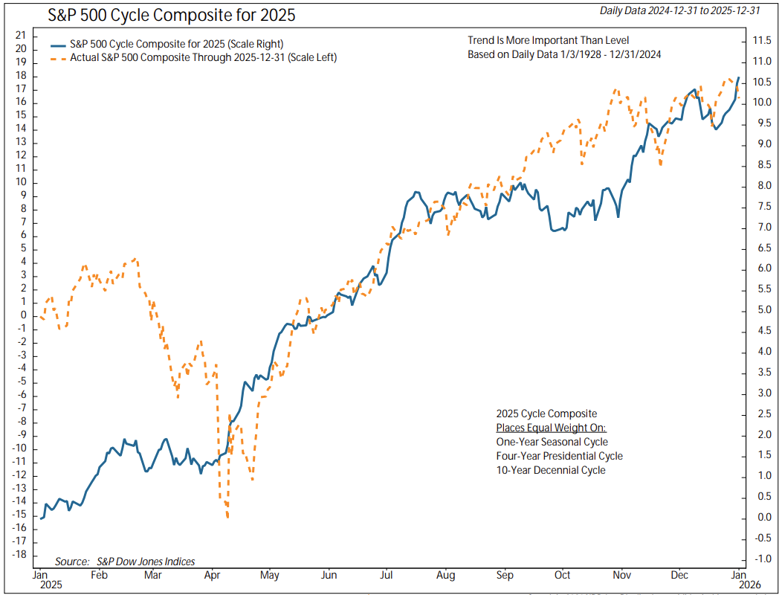
S&P 500 – 2025
Source: Ned Davis Research

Slide 22
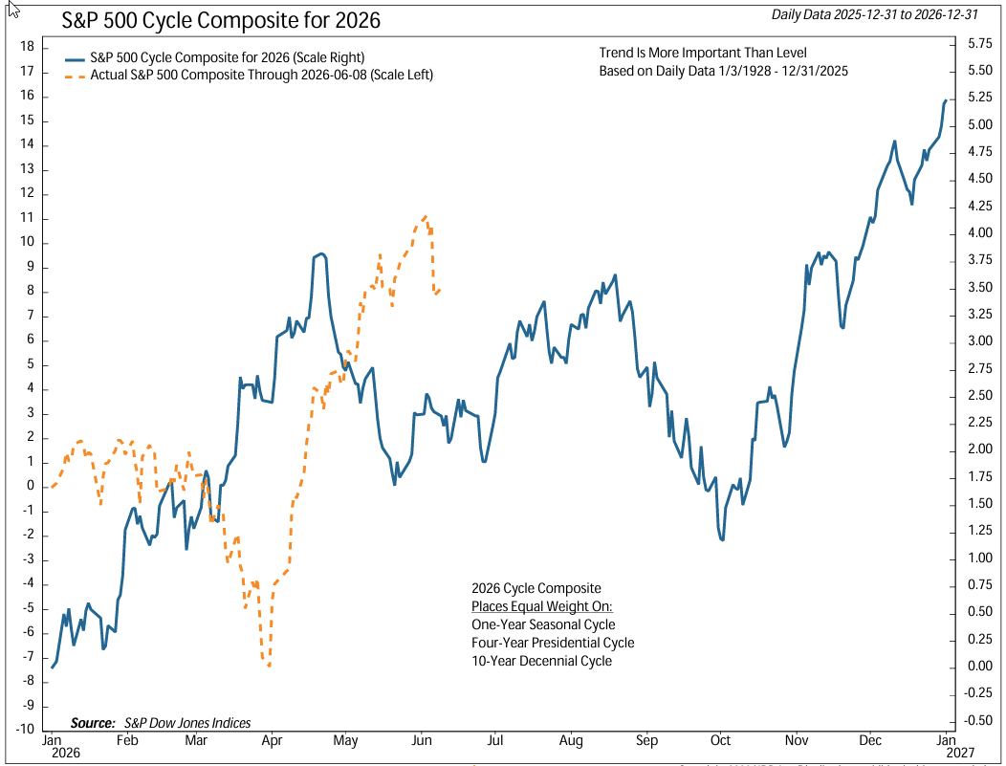
S&P 500 – Bull but Buckle Up
Source: Ned Davis Research

Slide 23
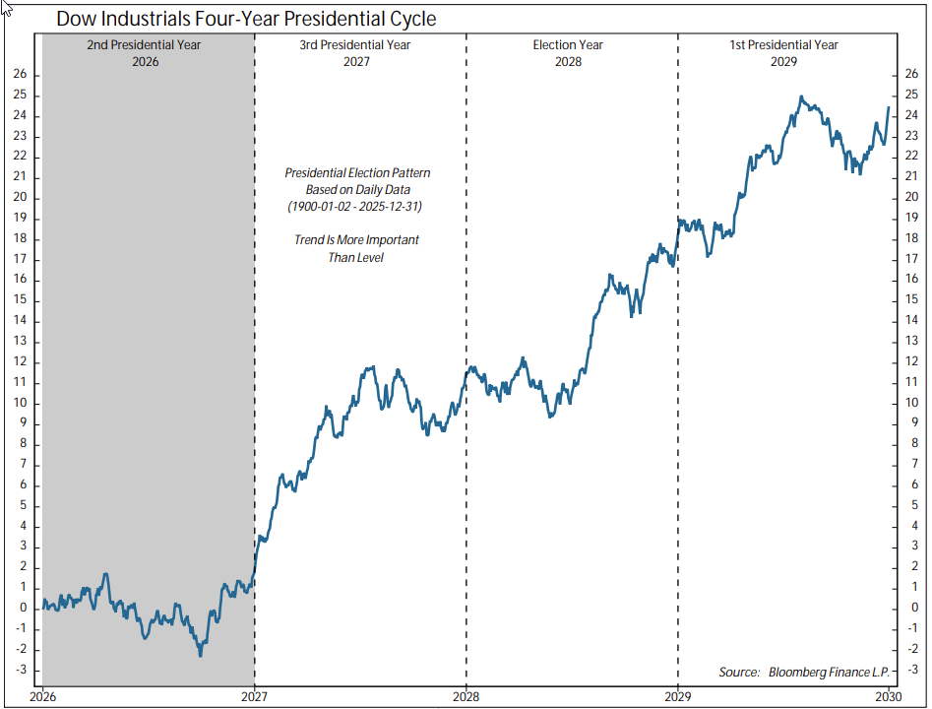
Four – Year Presidential Cycle
Source: Ned Davis Research

Slide 24
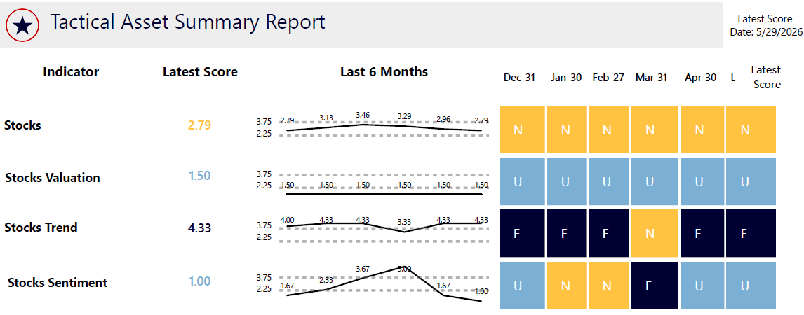
Markets Summary
Wall Street still pricing teens earnings growth, margins
Late cycle Bull – expect turbulence
  Solid – even improving earnings this year and next
Valuations – off Highs Trend – Up Sentiment – Frothy
40-year Bull in interest rates is over
Expect long rates around 4.5%
20-year Commodity cycle underway
Source: Texas Capital Private Bank Investment Committee
Notes:
Think 3 4 3 12

Slide 25
Paths
Notes:
Touched on rates, inflation, jobs, overall economy Where do we go from here?

Slide 26
Economic Paths – June 2026
Today
Path
NTM
Pre-war GDP est +2.5% shifting up to 2nd gear
2026 GDP at least 3% - above consensus call
2026 earnings growth low double digits
Fed on Hold
Summary
Employment, inflation, retail sales remain steady
Growth biased to accelerate
Core CPI >3% for 41 of the last 60 months
Global GDP re-accelerates in Q3
Tariffs negotiated < 10% China plays
S&P 500 stumble summer hits new highs
Fed No cut but tightening bias
CPI peaks at 4.5%, drifts down to 2.7% as oil prices recede
GDP: +3.7%
CPI: +3%
Earnings +18%
10Y Treasury: 4.5%
Unemployment: 4%
High
20%
Global commodities shortage spares U.S. until Q4
OBBB tax breaks push GDP >3%
Earnings +14%; War resets multiple
Stocks struggle early but finish positive
1 unnecessary cut; end ‘26 3.25 – 3.5%
GDP: +3%
CPI: +3.5%
Earnings +14%
10Y Treasury: 4.3%
Unemployment: 4.3%
Base
45%
Global commodities shortages persist into ’27; food shortages start in fall
Asia, Euro energy recession
China restricts metals
CPI becomes volatile; moving > 4.5%
Fed 4 cuts; end year at 2.50% - 2.75%
GDP: +0.5%
CPI: +4.25%
Earnings: +7% falling
10Y Treasury: 3.5%
Unemployment: 6%
Low
35%
Sources: Bloomberg, S&P Capital IQ, FactSet,, US Treasury, The Federal Reserve, Texas Capital Private Bank
Notes:
20% recession 1 in every 5 years

Slide 27

Economy Paths – Structural Changes
70 Year Global Trade Cycle is over
  “Peaceful” rules environment being replaced
Source: stock.adobe.com/world peace
Source: Texas Capital Private Bank Economics
Notes:
Think 3 4

Slide 28
Economy Paths – Structural Changes
70 Year Global Trade Cycle is over
  “Peaceful” rules environment being replaced
What matters next 20 years?
  Globalized “just-in-time” system gives way to
  Strategic Independence, vertical integration
Transition
  Messy, inflationary, new alliances
  Data and data security
  Food supply
  Critical minerals
Winners:
  Power, Water, Education, Industrial Capacity
  Will to use it
Source: Texas Capital Private Bank Economics
Notes:
Think 3 4

Slide 29
DEEP

Slide 30
Demographics

Slide 31
Birthrate trend – U.S.
Today’s college students
Today’s K - 3
Source: Bloomberg, Census
Notes:
We have roughly 2000 years of econ stats that are pretty good There are Sumarian crop price data that is 4k yrs old.
So we are pretty confident that the best economic growth comes when families are forming and having children
The US is the best birth story in the developed world The only countries having replacement level births are in areas of weak rule of law.
What does this mean Japan 50 years ago had 16 grandchildren to look after grandparents Today its barely 1 There are businesses that clean up after dead people because no one knew they had passed. S Korea will be there in about 5 years.
We in the US gripe about social media
Overseas they are griping about extinction Who are you going to sell to?

Slide 32
Demographics – Family Formation
Median age for first home rising
“Affordability”
Real issue is Congress - Glass-Stegall, Frank & Dodd, Dodd-Frank 2010
  Pushed out banks and small lenders
  Almost eliminated non-traditional (“W-2”) borrowers
  Higher denial rates
  Increased lender compliance
  TRID disclosures add days to close
Result: 2010 short 300,000 homes
    2026 short 4 million homes
Need:
  Repeal of certain parts of D-F
  Land use de-regulation
  Portability of mortgages
  Community banks hold mortgages
M&A Boomer Boom = shift healthcare from babies to waiting rooms
Source: Texas Capital Private Bank Economics
Notes:
Family formation

Slide 33
Demographics Summary
  Population growth north of equator basically stopped
  Exceptions:
    U.S. ~7 years out
    N.Z.
3 Generations: more deaths than births
    China Birthrate dropped 17% last year
    France Newest member of the decline club
    Germany 1st Place 1973
    U.K. Next out
Population growth:
    Weak rule of law
    Food / energy less available
Birth rates strongly correlate to food chain
Immigration only partially solves long term growth concerns
Question: Who are you going to sell to?
Source: Texas Capital Private Bank Economics

Slide 34
Education

Slide 35
Education
Space Race through 2022: Must go to college
  College Costs Drivers
    Building Race (lazy river!)
    Professor Salaries
    Free Funding from Student Loans after 2008
Next:
    170+ Majors How many do you employ?
    Sectorization Brands, Skill, Trade, Time collapse
    M&A Real Estate play, merge to survive
Art Levine, Brandeis University
    System based on time, not mastery
    Need skills and competency
Sian Beilock, Darthmouth College
    Is a Four-Year Degree Worth It?, WSJ Opinion 25 January
    Affordability, measurable return on tuition, guarantee internship
“Mississippi Miracle” 4th grade reading: 49th in 2013, 9th in 2024
Name the two worst jobs in the world?
Source: Texas Capital Private Bank Economics
Notes:
The idea that you must spend 3 or 4 years in college
IF your football team turns over every 2 years why should you stick round?
Remember the us birth rate graph? Worst job
Schools must change to produce a work force capable of meeting a flat population consumption society

Slide 36
Energy & Engineering

Slide 37
Energy & Engineering
  A.I. Boom
    Focus on aging Power Grid
    Natural gas turbines and ICE 4 year waiting list
    Stargate 1 and others: repurposed Bitcoin mining
    Fade the excitement please: See PJM and token pricing!
    SLM and Focused Applications are next Turbovec
Next M&A targets:
    SMR Holtec, NuScale, Oklo, TerraPower, GE, Rolls
    Robots 12 Humanoid Harold & George
    Infrastructure Steel & Rare Earths, Hertha
Crude Production
    Easy fracking in US is done
    Saudi back to swing producer - 40% of M.E. crude leaving via pipes
    Marginal: Venezuela
    Ras Lafan Qatar: at least 4 years
Source: Texas Capital Private Bank Economics
Notes:
Google Gemini hallucinations

Slide 38
Policy

Slide 39
Policy Today
Headwinds
Oil is the headlines; but fertilizer, helium shortages
Threat to leave USMCA
    Review due July 1st
    Trump can threaten to leave at any time
    $1.6T / yr so will be a deal
    Expect Trump noise to ramp up
Tailwinds
Supreme Court dumped IEEPA Tariffs
    Refunds underway; Treasury borrows another $166B this year
    §122, then §232 & §301 this fall
    Stated tariffs 15% Average tariffs fall to ~8%
  EPA rescinds 2009 Endangerment finding
    Lawyer annuity program
Up Next
  Odds on a Supreme Justice retiring rising
Source: Texas Capital Private Bank Economics
Notes:
We think tariffs end up around 8% steady state won’t be reached until end of 27

Slide 40
Policy Spring
Its all about China visits
    Consolidate the Americas
      Neutralize China in the south
      Get Iran out of Venezuela, Cuba (done?)
      Pressure Canada to quit dealing w China
    Greenland
      Leverage over US: rare earths and northern trade route
  Run economy hot – like never before
      Midterm election years are the best for growth
      AND Amazing stimulus this cycle
        $1 Trillion total in tax measures
        $100 Billion tax refunds
        $200 Billion business investment
        $300 Billion expansion of Fed balance sheet
        $200 Billion GSE mortgage purchases
        Financial Deregulation & SLR changes
Don’t expect much from Congress this year
    Clarity Act crypto firms paying interest, DeFi who is in charge?
    Permitting reform: electricity prices help get oil and gas out
Source: Texas Capital Private Bank Economics

Slide 41
Policy Rest of the Year – Most Important Slide!
Fiscal Policy
    Tax and spend by legislatures and Congress
      More states cutting than raising
      OBBBA impact starts next month with refunds
Monetary Policy
    Interest rates, Fed and inflation
      Last Fed action was a cut – so in easing mode
      Thanks to Congress Treasury issues more debt
      Fed buys debt creating money in banking system: M2
      M2 is growing at 4.6% - well above inflation
Credit Policy
  Congress, Regulators, Markets
    Easier credit with banking deregulation
    Private credit readily available – but landscape changing…
    New appetite for commercial real estate loans
  Summary: All 3 in Stimulus Mode Rarely if ever
Source: Texas Capital Private Bank Economics

Slide 42
Policy - Geopolitical
Five Wars
    Name Them!
    Get it Strait
      Rocket targets: water over oil
      NOT 1970s embargo vs turn off
      Waiting game has worked against U.S. for 45 years
  How long to rebuild?
    Key: LNG #1 concern for Asia electricity generation
    Deliveries to Asia; restart plants
    Ras Lafan press release: 4 years for sure up to 5 years for full repairs
Russia big winner in March – But May? Now hat in hand to Europe
China learning many lessons
Source: Texas Capital Private Bank Economics

Slide 43
Outlook for 2026 Real GDP Growth
OK
Blah
Good
+2%
+1%
2025
-1%
+3%
Crummy
Great
2026 Forecast
2024
+5%
-3%
Data Source: Texas Capital Private Bank Economics
*Data as of December 31st, 2025
Notes:
Updated

Slide 44
Summary
2026 at least 3% GDP growth
Inflation 4% but trending higher
Interest rates return 3% as rates drift higher
Stock market healthy rotation away from Mag 7, bumpy mid-term year
  But rebound ~12% return
Commodities +30%
Need more kids, rare earths and electricity
Source: Texas Capital Private Bank Economics

Slide 45
Thank You

Slide 46
EMPLOYMENT
Data Source: Texas Capital Private Bank Economics
*Data as of December 31st, 2025
Notes:
Updated

Slide 47
Labor Market Conditions are Stabilizing
Employment gains are broadening with Unemployment Rate steadying
Government & Healthcare Jobs
Industries are adding jobs
Source: Bloomberg
Source: Bloomberg
3 Month Average Unemployment
Mean Duration Unemployment
Source: Bloomberg
Source: Bloomberg

Slide 48
CONSUMER
Data Source: Texas Capital Private Bank Economics
*Data as of December 31st, 2025
Notes:
Updated

Slide 49
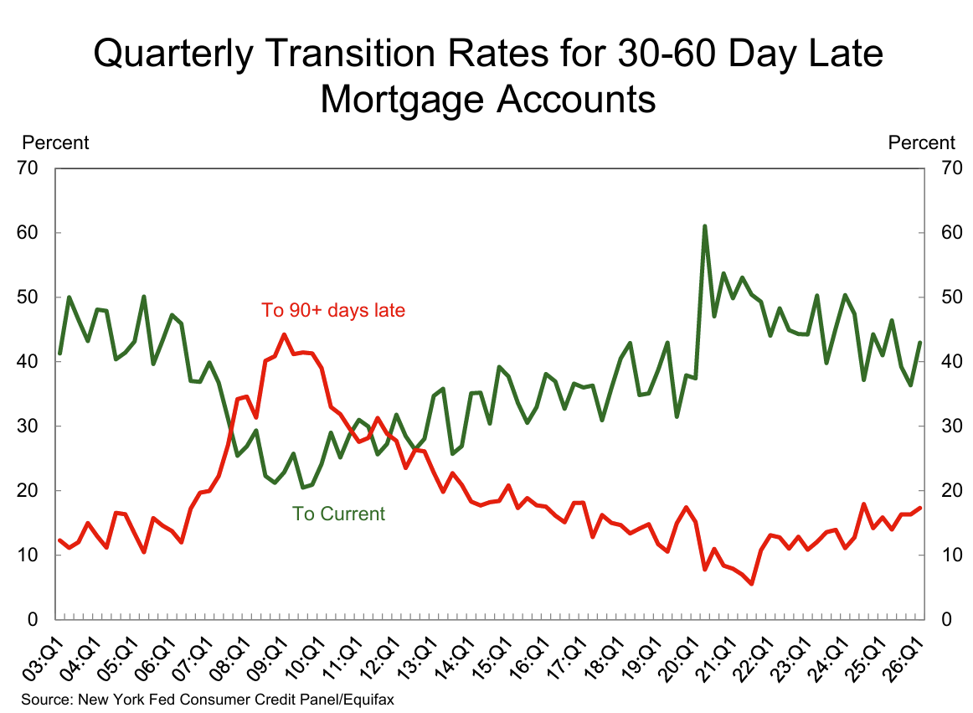
Notes:
Updated

Slide 50
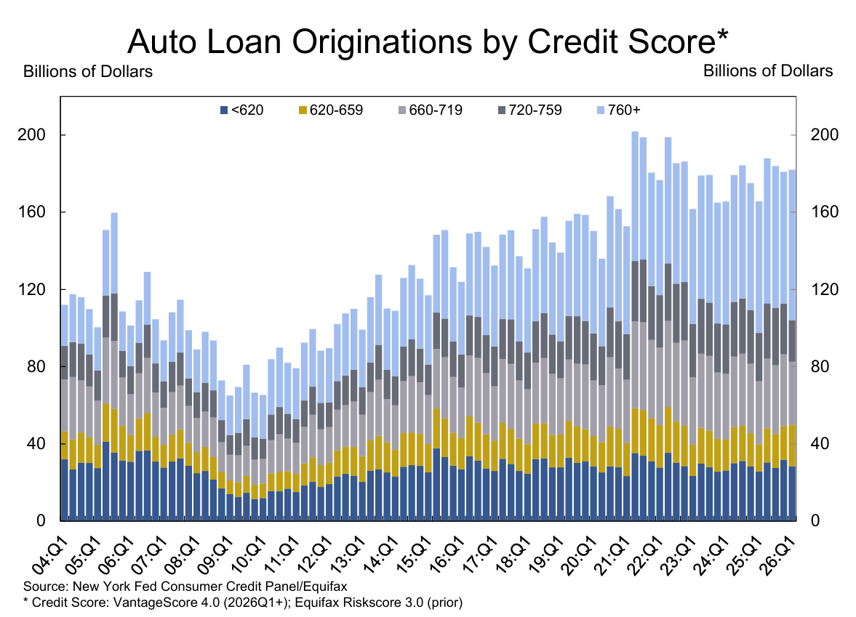
Data Source: Texas Capital Private Bank Economics
*Data as of December 31st, 2025
Notes:
Updated

Slide 51
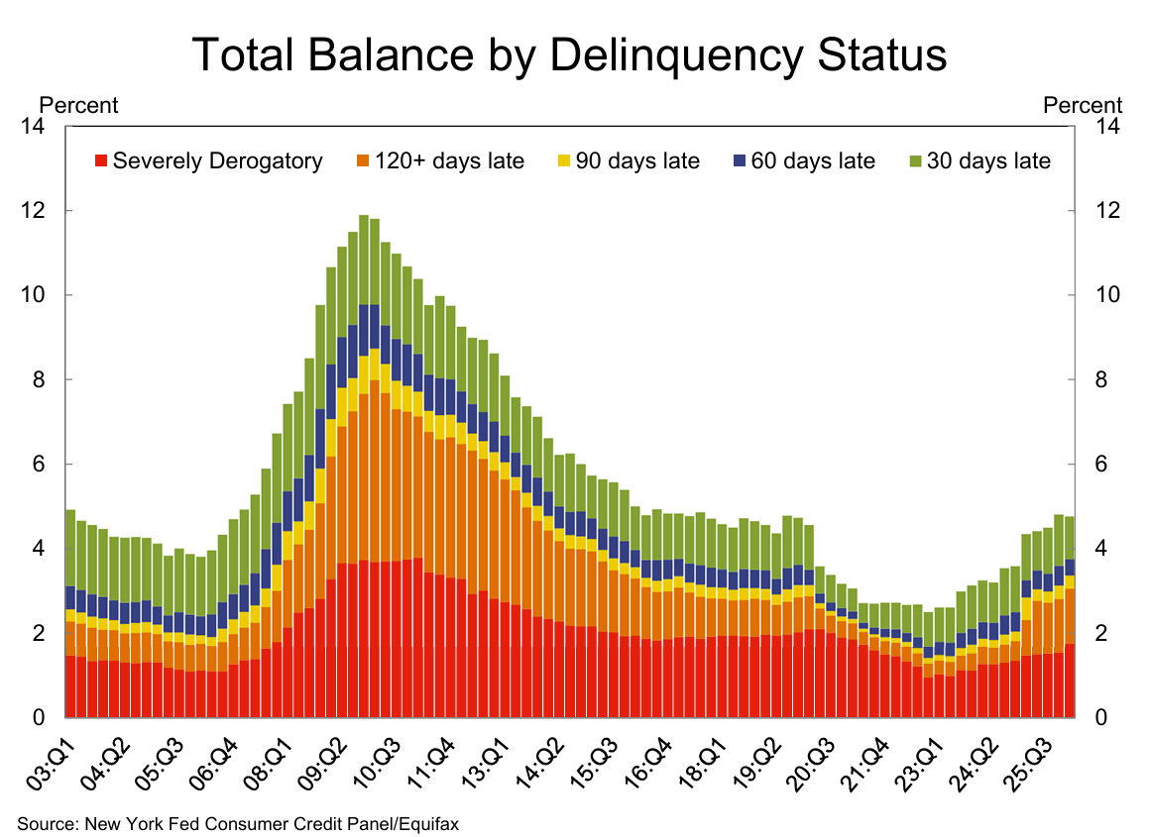
Data Source: Texas Capital Private Bank Economics
*Data as of December 31st, 2025
Notes:
Updated

Slide 52
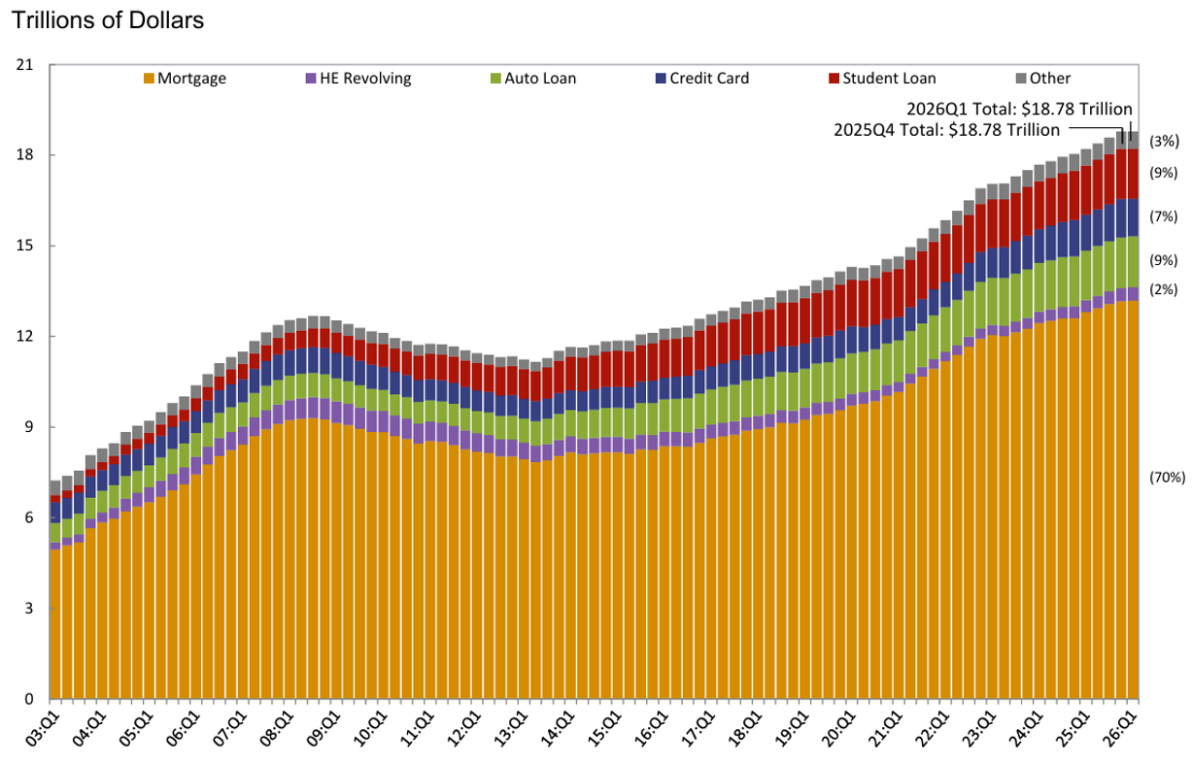
Total Household Debt by Type
Source: New York Fed Consumer Credit Panel / Equifax

Slide 53
INFLATION
Data Source: Texas Capital Private Bank Economics
*Data as of December 31st, 2025
Notes:
Updated

Slide 54
Historical Inflation vs Fed Funds
Data Source: Bloomberg
*Data as of January 23rd, 2025

Slide 55
Historical US Consumer Price Inflation
Data Source: Bloomberg
*Data as of June 2026

Slide 56
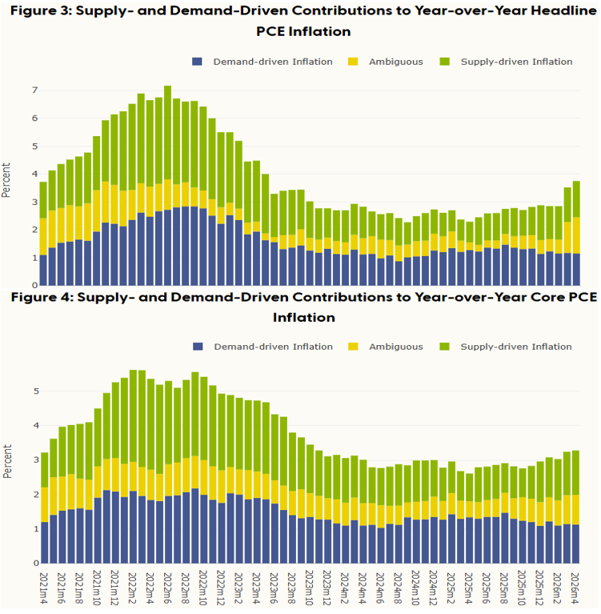
PCE Inflation
Data Source: Federal Reserve Bank of San Francisco

Slide 57
Repeat of the 80s?
Is history repeating itself? “The last mile of fighting inflation is a marathon rather than a sprint.” – Torsten Slok
Source: Bloomberg, Apollo Chief Economist

Slide 58
THE FED
Data Source: Texas Capital Private Bank Economics
*Data as of December 31st, 2025
Notes:
Updated

Slide 59
A Surprisingly Hawkish June FOMC
“Members of the FOMC are unambiguous and unanimous: this Committee will deliver price stability” – Warsh
June 2026 FOMC Dot Plot
Historical Median FOMC Projections vs Realized
Source: Bloomberg
Source: Bloomberg
Largest 2y Treasury Selloff on FOMC Day Since 2022
Resurgent Inflation Seen by Fed
Source: Bloomberg
Source: Federal Reserve, Bloomberg
^{1. Using May 2026 CPI for PCE}

Slide 60
Current State of the Fed
Kevin Warsh inherits a challenging environment for the FOMC, eager to affect change
Warsh Assumes Highest Rate Env Since Greenspan
Decade’s Long Trend of Declining Confidence in the Fed
Source: Bloomberg
Source: Gallup
The Fed is the Most Divided in over 30 years
FOMC Minutes Hawkish vs Dovish
Source: Bloomberg
Source: Bloomberg

Slide 61
RATES
Data Source: Texas Capital Private Bank Economics
*Data as of December 31st, 2025
Notes:
Updated

Slide 62
2y UST Leading Indicator for Fed Funds Rate over Time
Current 2y US Treasury Yield: 4.15%
Source: Bloomberg (6/18/2026)
Source: US Department of The Treasury

Slide 63
Fed Funds Rate vs 10y UST Yield
Data Source: Bloomberg
*Data as of June 18, 2026

Slide 64
Historical 1mo Cash Rate vs Forward Curve
Source: Bloomberg
Data as of May 19, 2026

Slide 65
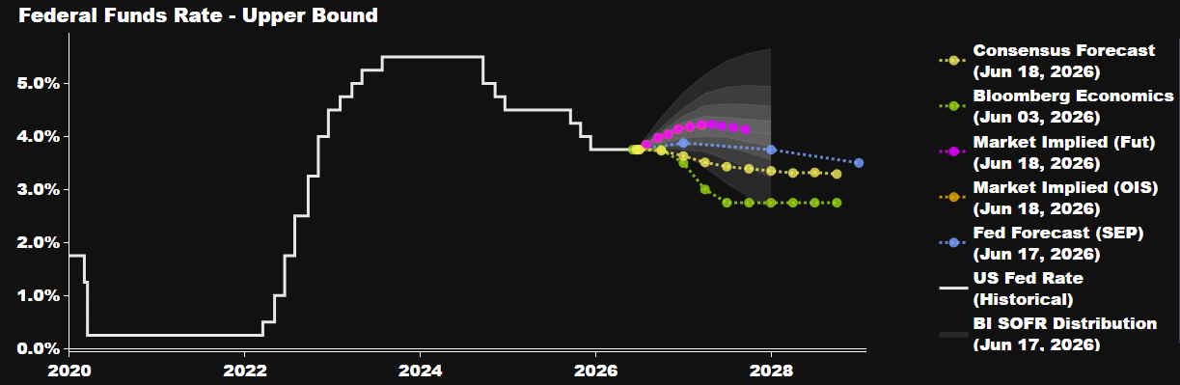
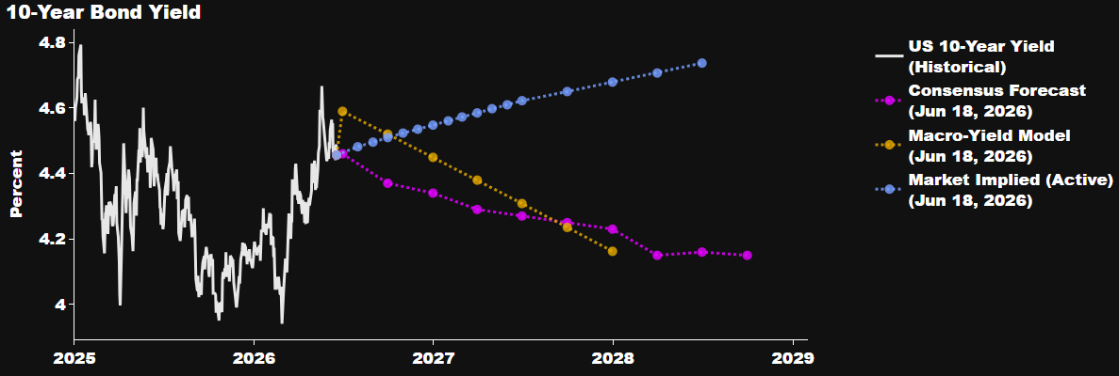
Interest Rate Projections
Source: Bloomberg

Slide 66
Thank You

Slide 67
Appendix

Slide 68
Index Descriptions
Fixed Income | Barclays Aggregate Index Measures the changes in the fixed rate debt issues rated investment grade or higher by Moody’s Investors Service, Standard and Poor’s, or Fitch Investor’s Service, in that order. All issues must have at least 1 year left to maturity and have an outstanding par value of at least $300 million. The Aggregate Index is comprised of the Government/Corporate, the Mortgage-Backed Securities and the Asset-Backed Securities indices.
International Equity | MSCI EAFE (Europe, Australasia, Far East) A free float-adjusted market capitalization index that is designed to measure developed market equity performance, excluding the United States & Canada. The EAFE consists of the country indices of 21 developed nations. With Net Dividends: This series approximates the minimum possible dividend reinvestment. The dividend is reinvested after deduction of withholding tax.
Large Cap | Standard & Poor’s 500 (S&P 500) Measures changes in stock market conditions based on the average performance of 500 widely held common stocks. It consists of 400 industrial, 40 utility, 20 transportation and 40 financial companies listed on US market exchanges (mostly NYSE issues). It is a capitalization-weighted index calculated on a total return basis with dividend reinvested. The S&P 500 represents approximately 68% of the investable U.S. equity market.
Large Cap Growth | S&P/BARRA 500 Growth Index is constructed by dividing the stocks in the S&P 500 Index according to price-to-book ratios. The Growth indices contain stocks with higher price-to-book ratios. The indices are market-capitalization-weighted and their constituents are mutually exclusive.
Large Cap Value | S&P/BARRA 500 Value Index is constructed by dividing the stocks in the S&P 500 Index according to price-to-book ratios. The Value index contains stocks with lower price-to-book ratios. The indices are market capitalization- weighted and their constituents are mutually exclusive.
Small Cap | Russell 2000 Index Measures the performance of the 2,000 smallest companies in the Russell 3000 Index, which represents approximately 8% of the investable U.S. equity market. As of the reconstitution on December 31, 2008, the average market capitalization was $897 million; the median market capitalization was $321 million. The index had a total market capitalization range of $3.3 billion to $70 million.
Small Cap Growth | Russell 2000 Growth Index Measures the performance of those Russell 2000 companies with higher price-to-book ratios and higher forecasted growth values. The Russell 2000 measures the performance of the 2,000 smallest companies in the Russell 3000 Index. As of December 31, 2008, the average market capitalization was approximately $918 million; the median market capitalization was approximately $321 million. The index had a total market capitalization range of approximately $3.2 billion to $70 million.
Small Cap Value | Russell 2000 Value Index Measures the performance of those Russell 2000 companies with lower price-to-book ratios and lower forecasted growth values. The Russell 2000 measures the performance of the 2,000 smallest companies in the Russell 3000 Index. As of December 31, 2008, the average market capitalization was approximately $858 million; the median market capitalization was approximately $318 million. The index had a total market capitalization range of approximately $3.3 billion to $70 million.
HFRI Fund Weighted Composite Index | HFRI Fund Weighted Composite Index: a global, equal-weighted index of over 2,000 single-manager funds that report to HFR Database. Constituent funds report monthly net of all fees performance in US Dollar and have a minimum of $50 Million under management or a twelve (12) month track record of active performance. The HFRI Fund Weighted Composite Index does not include Funds of Hedge Funds.
Emerging Markets | MSCI Emerging Markets Index: A free float-adjusted market capitalization index that is designed to measure equity market performance of emerging markets. As of December 31, 2010, the MSCI Emerging Markets Index consists of the following 21 emerging market country indices: Brazil, Chile, China, Colombia, Czech Republic, Egypt, Hungary, India, Indonesia, Korea, Malaysia, Mexico, Morocco, Peru, Philippines, Poland, Russia, South Africa, Taiwan, Thailand and Turkey. With Net Dividends: Net total return indices reinvest dividends after the deduction of withholding taxes, using (for international indices) a tax rate applicable to non-resident institutional investors who do not benefit from double taxation treaties.
There are inherent limitations to indices that are designed to track the alternative investments universe. Index data shown is for illustrative purposes only and is not designed to represent any specific investment. Specific investment statistics could differ materially from the data shown.
The Russell 1000®, Russell 2000®, Russell 3000®, Russell 1000 Growth®, Russell Midcap®, Russell 2000 Value® and Russell 2000 Growth® indices are trademarks of the Frank Russell Co.
Index returns do not reflect the deductions of fees, trading costs or other expenses. The Index is referred to for informational purposes only: the composition of each Index is different from the composition of the accounts managed by the investment manager. Investors may not make direct investments into any index. Past performance may not be indicative of future results.

Slide 69
Disclosures
Texas Capital is the collective brand name for Texas Capital Bank (“TCB”) and its separate, non-bank affiliates and wholly-owned subsidiaries. Texas Capital Private Bank™ refers to the wealth management services offered by the bank and non-bank entities comprising the Texas Capital brand. Deposit and lending products and services are offered by TCB. For deposit products, Member FDIC. TCB is not a registered broker-dealer or registered investment adviser and does not offer brokerage or investment advisory services. Investment advisory services are provided by Texas Capital Bank Private Wealth Advisors (“PWA”). Texas Capital Bank Private Wealth Advisors is the trade name used by Texas Capital Bank Wealth Management Services, Inc., an investment adviser registered with the U.S. Securities and Exchange Commission (“SEC”). SEC registration does not constitute an endorsement of the advisory firm by the SEC, nor does it indicate that the advisory firm has attained a particular level of skill or ability. Securities brokerage accounts and investment-related products and services are offered through Texas Capital Securities. Texas Capital Securities is the trade name used by TCBI Securities, Inc., an SEC and MSRB-registered broker-dealer and member FINRA/SIPC. PWA, Texas Capital Securities and TCB are affiliated companies under the common control of Texas Capital Bancshares, Inc. TCB and its subsidiaries and affiliates do not provide legal, tax or accounting advice.
INVESTMENTS: NOT FDIC INSURED | MAY LOSE VALUE | NO BANK GUARANTEE
________________
Investing is subject to a high degree of investment risk, including the possible loss of the entire amount of an investment. You should carefully read and review all information provided by PWA, including PWA’s Form ADV, Part 2A Brochure, Form CRS, and all supplements thereto, before making an investment.
The information contained herein reflects the current expectations, opinions and projections of PWA as of the date of publication, which are subject to change without notice at any time subsequent to the date of issue. PWA does not represent that any expectation, opinion or projection will be realized. While the information presented herein is believed to be reliable, no representation or warranty is made concerning the accuracy of any data presented. Neither PWA nor any of its advisers, officers, directors, or affiliates represents that the information presented in this presentation is accurate, current or complete, and such information is subject to change without notice. Prospective investors should not treat these materials as advice in relation to legal, taxation, or other matters. No representations or warranties whatsoever are made by PWA or any other person or entity as to the future profitability of an investment account or the results of making an investment. Projected or past performance is not a guarantee of future results. Nothing herein is intended to constitute an offer to sell or buy, or a solicitation of an offer to sell or buy securities.
Statements herein that reflect projections or expectations of future financial or economic performance are forward-looking statements. Such “forward-looking” statements are based on various assumptions, which assumptions may not prove to be correct. Accordingly, there can be no assurance that such assumptions and statements will accurately predict future events or PWA’s actual performance. Any projections and forward-looking statements included herein should be considered speculative. Actual results for any period may or may not approximate such forward-looking statements. You are advised to consult with your independent tax, legal and business advisors concerning the validity and reasonableness of the factual, accounting and tax assumptions.
Performance of any managed or advisory account program strategies and/or disciplines illustrated in this Proposal are presented "gross of fees". Gross performance presentations allow for consistent comparisons of these strategies and/or disciplines to a benchmark index or indices. The returns presented in this Proposal, including the applicable benchmark index or indices, do not reflect the impact of the fees and expenses associated with the investment(s), the deduction of which would decrease results. For example, an advisory fee of 1% compounded over a 10- year period would reduce a 10% return to an 8.9% annual return. Such fees and expenses may include, without limitation, a manager fee, an advisory fee, a platform fee, and commissions charged on transactions. Fees may vary by managed or advisory account program, investment manager and client and the net effect of the deduction of fees on annualized performance will vary over time depending on account size, time period and overall investment performance. You should discuss applicable fees with your advisor. The fees are disclosed in published fee schedules, which are available upon request. The performance results illustrated herein do not reflect the impact of taxes.
This presentation and its contents are confidential and proprietary information of PWA and any reproduction of this information, in whole or in part, without the prior written consent of PWA is prohibited. Additional information is available from PWA upon request. PWA is not acting as your adviser or agent unless and until you and PWA sign an investment advisory agreement.

